Slide 1

presents
HTML & CSS

Slide 2

HTML Basics
Dividers and Tags
Semantic Elements
Attributes
The Box Model
Links & Anchors
Best Practices

Slide 3
What is HTML?

Slide 4
HTML is a markup language
A markup language is a system for annotating a document in a way that is syntactically distinguishable from the text, meaning when the document is processed for display, the markup language is not shown, and is only used to format the text.
HTML uses Tags to markup elements
Tags are hidden keywords within a web page that define how your web browser must format and display the content.
Notes:
Tags are hidden keywords within a web page that define how your web browser must format and display the content

Slide 5
<p>Here is another tag!</p>
Basic tag structure:
<h1>Let's learn some stuff!</h1>
*Most tags require a closing tag to be valid
Notes:
Tags are hidden keywords within a web page that define how your web browser must format and display the content

Slide 6
Basic page structure:
<!DOCTYPE html>
<html>
<head>
<title></title>
</head>
<body>
</body>
</html>
The <!DOCTYPE html> declaration defines this document to be HTML5
The <html> element is the root element of an HTML page
The <head> element contains meta information about the document
The <title> element specifies a title for the document
The <body> element contains the visible page content
Notes:
The <!DOCTYPE html> declaration defines this document to be HTML5
The <html> element is the root element of an HTML page
The <head> element contains meta information about the document
The <title> element specifies a title for the document
The <body> element contains the visible page content

Slide 7
Don’t forget! The <head> is just information we want to tell the browser
We don't want to put any visible content in the <head> section.
Things that we want to be visible on the page belong in the <body> section.

Slide 8
One exception: the <title> tag
This is a tag that belongs in the <head> section that will be visible somewhere on the page.
<head>
<title>Demo</title>
</head>
*Where will this appear?

Slide 9
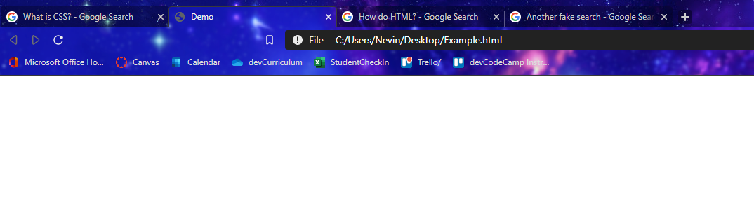
Here it is!

Slide 10
Basic <head> structure:
<head>
<meta charset="UTF-8">
<title>Demo Site</title>
<meta name="description" content=“A couple sentences describing the website.”>
<meta name="keywords" content="mike, demo">
<meta name="author" content="Mike">
</head>
<-- Specifies the character set
<-- Title for browser tab
<-- Data to help with SEO
<-- Data to help with SEO
<-- Data to help with SEO
Notes:
The charset attribute specifies the character encoding for the HTML document.
UTF-8 - most commonly used character encoding that most browsers understand (Unicode Transformation Format – 8bit)

Slide 11
Visible content inside the <body> :
<body>
<h1> Hello World </h1>
<h2> Welcome to my first site. </h2>
<p> My name is Mike. </p>
</body>
NB: When wrapping an element inside of another,
best practice is to start another line and indent everything over.
(Think of it like curly brackets in a programming language like JS or C#)

Slide 12
Styling text with tags:
<body>
<h1> Hello World </h1>
<h3> Welcome to my first site, <i>Flamingo</i>. </h3>
<p> My name is <strong>Mike</strong>. </p>
</body>
NB: The <i> and <strong> are not indented over.
Since these are only wrapping small chunks,
it doesn't make sense to break them up.
Remember: The end goal of new lines and indentation is for readability!

Slide 13
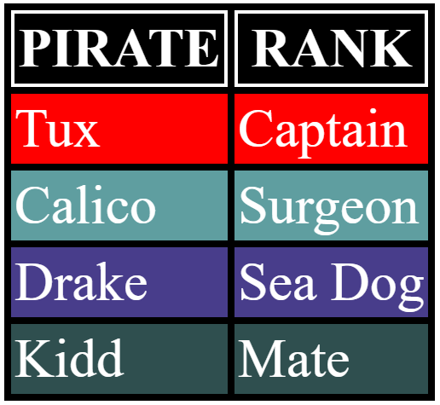
What would we need to make a table?

Slide 14
Table Syntax
<table>
<tr> <th> PIRATE </th> <th> RANK </th> </tr>
<tr> <td> Tux </td> <td> Captain </td> </tr>
<tr> <td> Calico </td> <td> Surgeon </td> </tr>
<tr> <td> Drake </td> <td> Sea Dog </td> </tr>
<tr> <td> Kidd </td> <td> Mate </td> </tr>
</table>

Slide 15
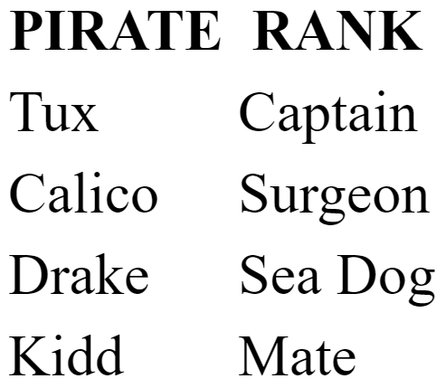
Where did the borders go?
For styling we would need CSS.
(More on that to come)

Slide 16
Once, tables were much more widely used (especially for layouts)
Now we tend to see more semantic layout elements and lists.
Semantic elements are ways we can logically group elements into page sections.

Slide 17
Semantic elements
have similar-sounding names & descriptions
header
nav
<header> - - - heading with intro
<nav> - - - - - - navigation
<section> - - - elements grouping
<article> - - - - self contained element
<footer> - - - - page footer
<aside> - - - - related sidebar
section
aside
article
footer
Notes:
A semantic element clearly describes its meaning to both the browser and the developer.

Slide 18
Attributes
Sometimes we need to give an <element> more information, such as how it should look or act.
You can set properties of elements by giving them attributes.
Attributes modify or provide additional information about an element.

Slide 19
You can set properties of elements by giving them attributes.
*Not valid HTML Code
Named property on an element that is given a value
The value that is assigned to the attribute
What the user sees on the page
Remember:
Attributes modify or provide additional information about an element
Notes:
Attributes provide additional information about an element
Attributes modify or add meaning to an HTML element.

Slide 20

<a href=“https://www.google.com”> Google </a>
Basic attribute usage on a hyperlink:
Closing Tag
Start Tag
Attribute
Value
What the user sees
The entire element
Notes:
anchor tag marks the beginning and the end of a hypertext link

Slide 21
<a href=“#jump_to_topic”> Jump to the topic </a>
Hyperlinks as page anchors
ID of the element you want to jump to
What the user sees
Element on page we jump to
<div id=”jump_to_topic”>Example stuff about topic</div>

Slide 22
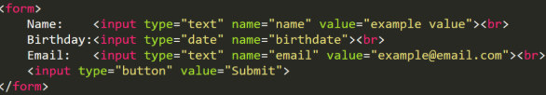
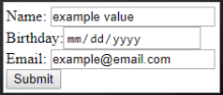
<form>
Creates a form that can house various elements to collect user input
&
<input>
One of a selection of elements that can exist within a form
Notes:
target attribute specifies where to open the linked document
src attribute is the image source (image.jpg) and alt is additional info about an image

Slide 23
Images
<img> tags are used to render images on a web page.
They have two required attributes, 'src' and 'alt'.
The 'src' attribute is used to tell the web page where the image is stored, usually a file path.
The 'alt' attribute is used to specify alternate text for the image if it cannot load the image.
Notes:
<br> line break
<a> marks the beginning and the end of a hypertext link (links to another page)
<span> groups inline-elements in a document and usually used for a small chunk of HTML inside a line (such as inside a paragraph)
<img> image tag used for an image
<script> script tag used for a script (JS or CSS)
<style> style tag used for internal styles
<link> defines a link between a document and an external resource (external style sheet)

Slide 24
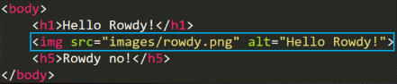

Relative pathing
Absolute pathing

Slide 25

Absolute pathing vs Relative pathing
Which one should I use?
DON'T USE ABSOLUTE PATHING
Don't do it
Wouldn't recommend it
Notes:
Alt is the text that appears if the image fails to load
Title is the text that appears when a user hovers over the image

Slide 26
Grouping & Separating Elements
If you need extra empty lines in your HTML, use: <br>
If you want to group elements together, use:
<span>
inline element
<div>
block line element

Slide 27
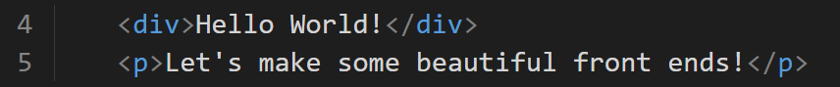
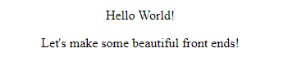
A <div> is used for large blocks of code and has line breaks (creates a new line after it).
Difference between
<div> & <span>
Notes:
Good example of span: Three dropdowns for birthday (month, day, year) all on the same line

Slide 28
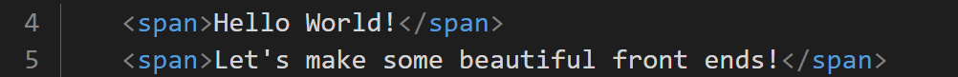
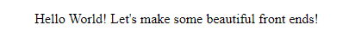
Difference between
<div> & <span>
A <span> is for small chunks of code in-line with no line breaks.
Notes:
Good example of span: Three dropdowns for birthday (month, day, year) all on the same line

Slide 29
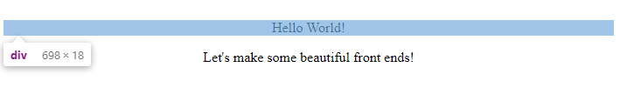
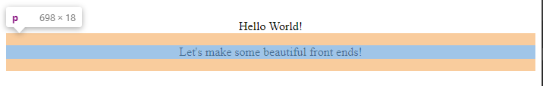
Block-Level Elements
Begin a new line
Take up the full width of parent element or page
Notable examples:
<ul>, <h1>, <h3>, <p>, <blockquote>, <div>, <form>

Slide 30
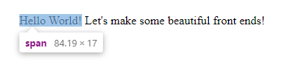
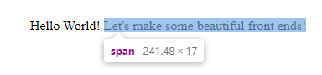
Inline Elements
Do not start a new line
They take the minimum width necessary
Notable examples:
<span>, <img>, <a>, <input>, <strong>, <script>,<textarea>

Slide 31
Commenting Code
You always have the option to add comments to your code that will not be rendered in the browser
This is useful for documenting what you have done, or adding notes for things you need to do
It is also good to remind yourself what external files are doing or which sections closing tags belong to
<!-- comment -->

Slide 32
Best Practices
Use lowercase when writing HTML
Try to keep your HTML file small
Tackle accessibility, search engine optimization, and performance as you go
Remove comments from production code
Notes:
Reserved characters in HTML must be replaced with character entities

Slide 33
Where do we put that other stuff?
CSS and JS

Slide 34
Want to start using Javascript and CSS on your pages?
We can use:
<script> & <style> & <link>

Slide 35
For Internal Styles:
<style>
[ styles here ]
</style>

Slide 36
For External Styles:
<link rel=“stylesheet” type=“text/css” href=“styles.css”>

Slide 37
For Internal Scripts:
<script>
[ scripts here ]
</script>

Slide 38
For External Scripts:
<script src=“script.js”></script>

Slide 39
We always want to load CSS first (in the head) and Javascript last (bottom of body).
This allows images and other assets to load faster

Slide 40
What is CSS?
CSS is a style sheet language and an abbreviation for “Cascading Style Sheets.”
CSS uses selectors and properties to style structured documents, like HTML.
This combination of selectors + properties allows CSS to apply specific styles to specific elements, and more!

Slide 41
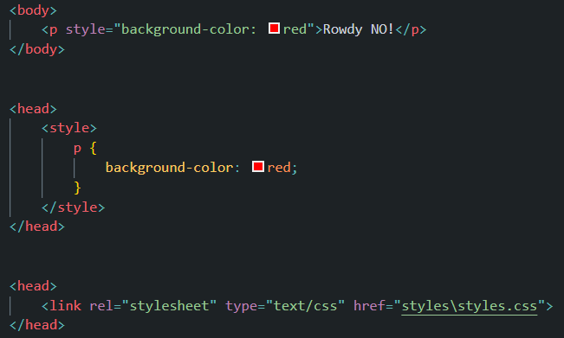
How to link CSS HTML
Inline
Internal
External

Slide 42
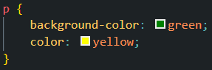
CSS Syntax
At its core, CSS operates by:
Declaring an HTML tag that will have rules applied
Opening its curly brackets { }
Placing styling rules inside the brackets { }

Slide 43
CSS Syntax
There are many styling properties out there that can be adjusted!
A developer can apply as few or as many styling rules as needed or desired.
The declared rules affect all occurrences of the tag in which they are declared.

Slide 44
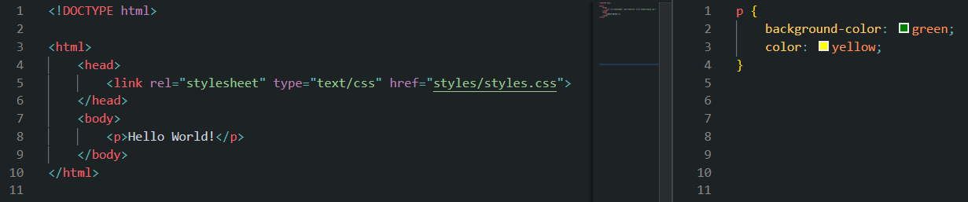

Basic CSS Example
HTML
CSS
CONTENT

Slide 45
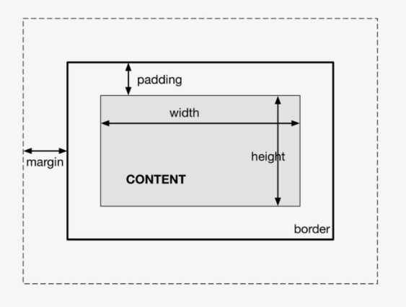
We utilize the box-model when visualizing the space taken up by an element.
The Box-Model

Slide 46
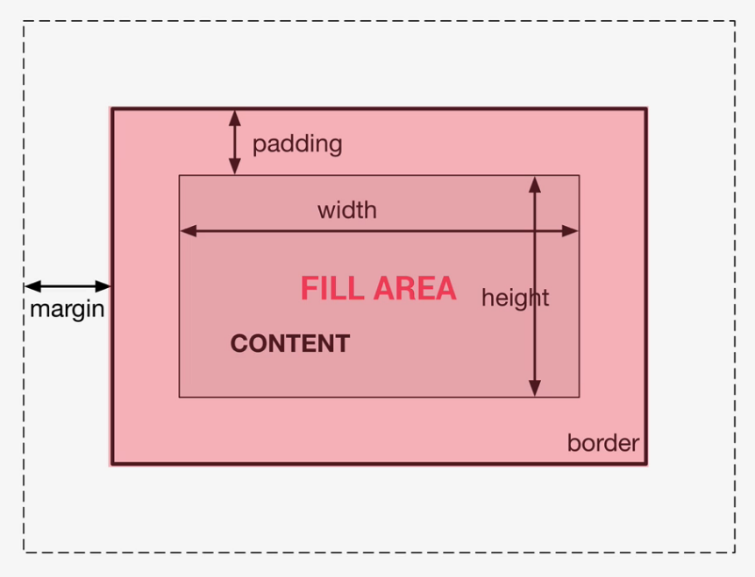
Box-Model
Content: text, img, etc
Padding: transparent area around content inside box
Border: goes around padding + content
Margin: space between boxes
Fill Area: area filled with background- color or background-image
Notes:
Tags are hidden keywords within a web page that define how your web browser must format and display the content

Slide 47
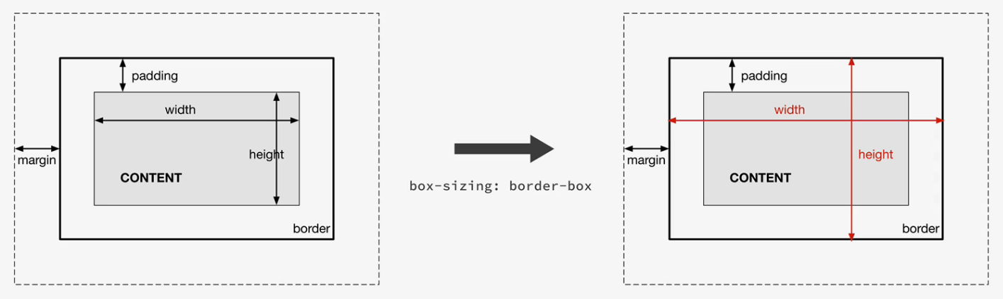
Box-Model: Height & Width
Total Height = T border + T padding + Specified height + B padding + B border
Total Width = R border + R padding + Specified width + L padding + L border
Notes:
Tags are hidden keywords within a web page that define how your web browser must format and display the content

Slide 48
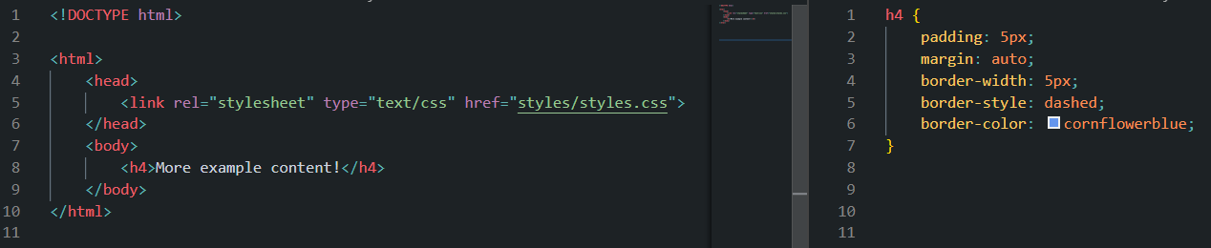
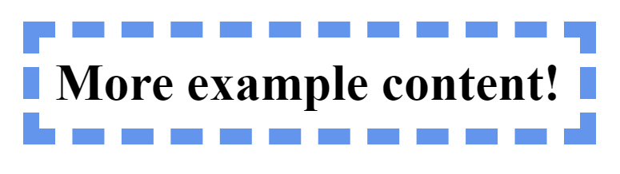
Box-Model Example
HTML
CSS
CONTENT

Slide 49
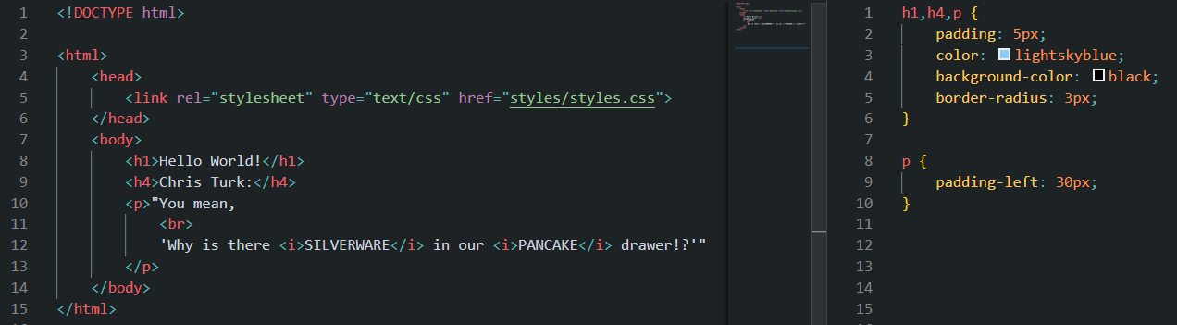
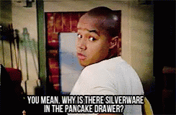
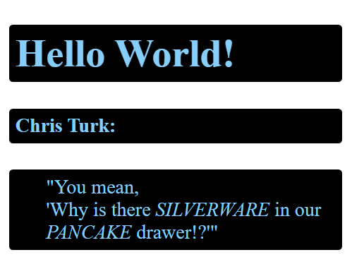
Multiple CSS Selectors
We can apply the same ruleset to multiple tags at the same time!!
Just separate the elements with a comma.
HTML
CSS
CONTENT

Slide 50
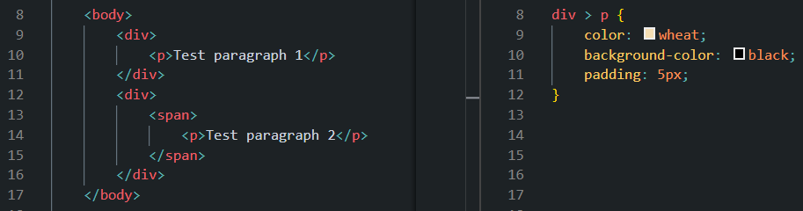
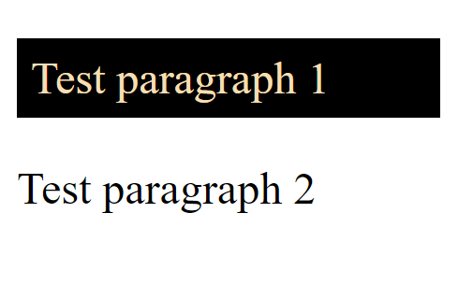
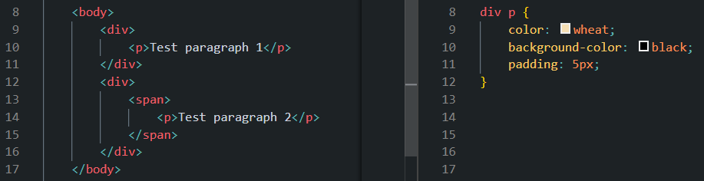
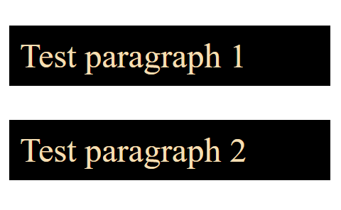
CSS Combinators
Child Selector: use > to separate two elements.
Styles are only applied if second element is immediate child of first.
HTML
CSS
Descendant Selector: use a space to separate the two elements.
All descendants receive styles.
CONTENT
HTML
CSS

Slide 51
CLASSes & IDs
In CSS, classes and IDs can be used to specify styling rules as well.
We can then apply these classes and/or IDs to any element(s) in our HTML with attributes!
Sometimes we don’t want the styles we set to be applied to all tags of the same type.

Slide 52
CLASSes & IDs
CLASS
May be used multiple times.
We can ‘chain’ multiple classes on an element.
Style precedence when chaining classes is determined by the order of the styles on the stylesheet, not the order the classes are chained in.
ID
IDs should only be used once on a page.
Only use one ID on an element.

Slide 53
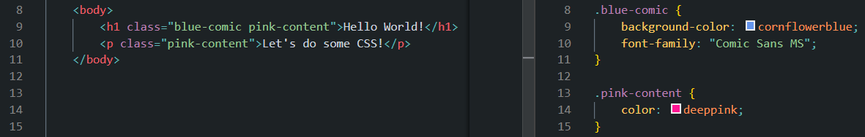
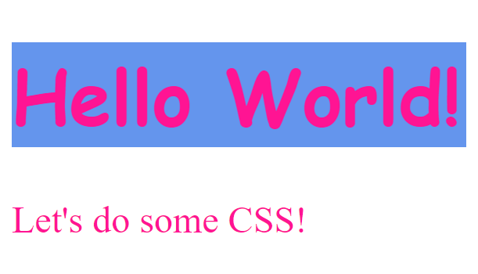
CSS Class Example
HTML
CSS
CONTENT

Slide 54
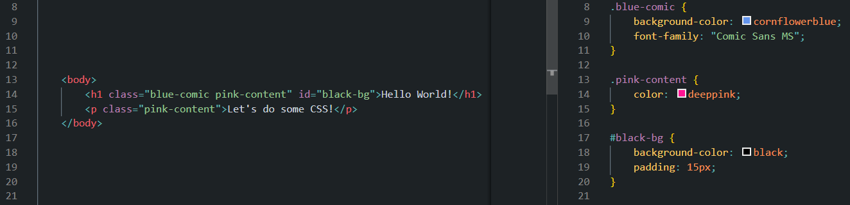
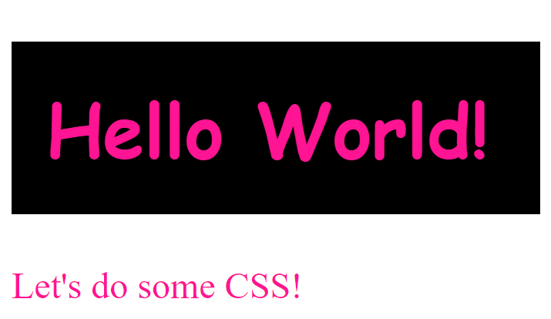
CSS ID Example
HTML
CSS
CONTENT

